Slide 1

GenAI Cybersecurity Threat Reporter
A Local RAG-Powered Intelligence System for Automated Threat Analysis and Reporting

Slide 2
Executive Summary
Project Vision
Technical Stack
This system leverages Retrieval-Augmented Generation (RAG) to transform raw threat intelligence into actionable security reports. By combining local LLM processing with vector database retrieval, it delivers real-time threat assessments without cloud dependencies.
Ollama (Gemma-4): Local LLM for threat analysis
LangChain: RAG pipeline orchestration
ChromaDB: Vectorized threat knowledge base
Streamlit: Interactive reporting interface

Slide 3
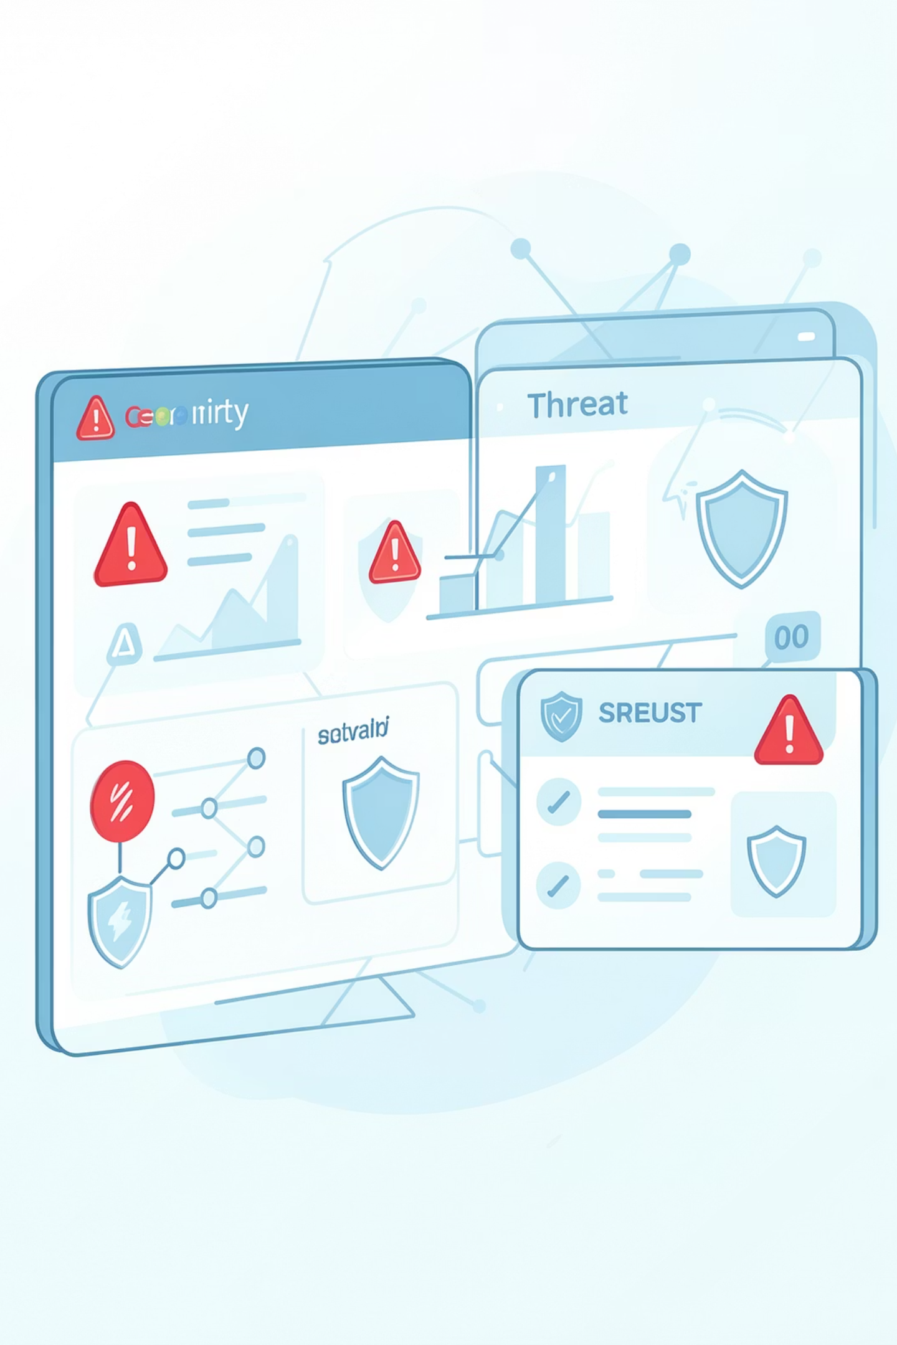
Problem Statement: The Cybersecurity Crisis
236%
8M+
Attack Growth
Daily Threats
Year-over-year increase in ransomware attacks (2023)
Unique malware variants detected daily worldwide
287
Days to Detect
Average time to identify security breaches
Security teams face information overload with fragmented threat intelligence sources. Manual analysis delays response times, creating critical security gaps that sophisticated attackers exploit.

Slide 4

System Architecture Overview
Ingestion Layer
Vectorization Layer
Retrieval Layer

Slide 5
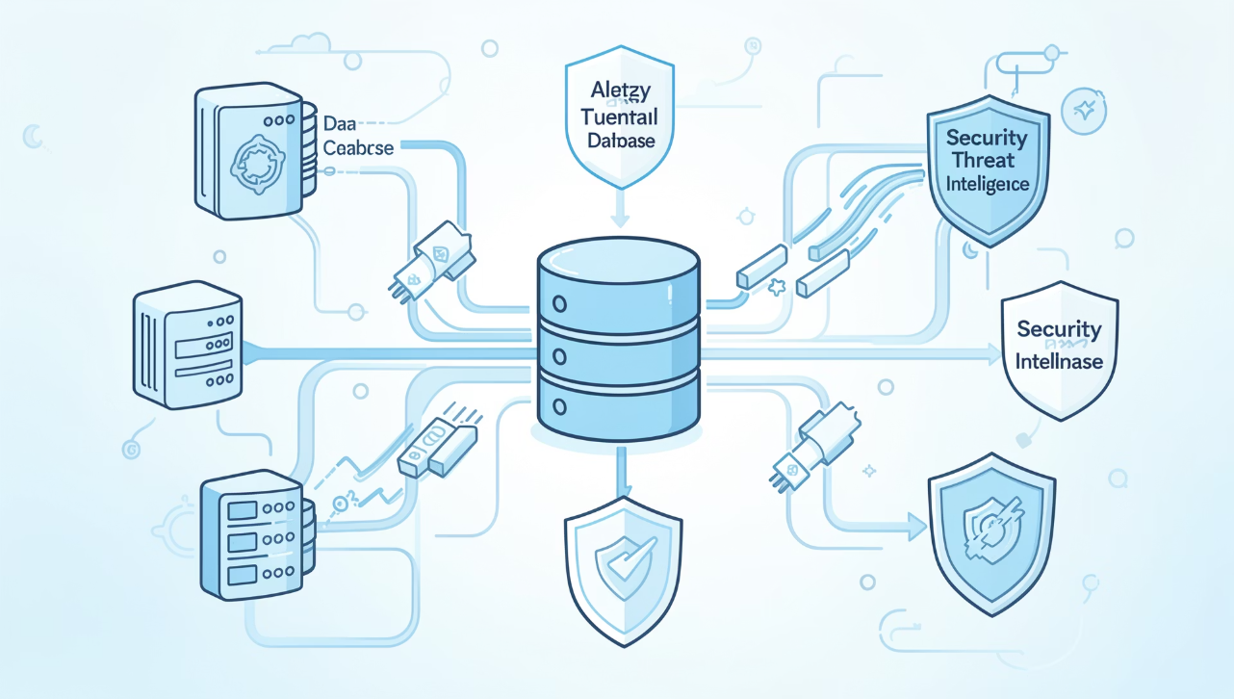
Stage 1: Data Ingestion & Preprocessing
Intelligent Data Collection
The ingestion layer automatically harvests threat intelligence from multiple authoritative sources including CVE databases, security advisories, MITRE ATT&CK framework, and dark web monitoring feeds.
Preprocessing Pipeline
Text normalization and cleaning
Entity extraction (CVE IDs, threat actors)
Severity classification tagging
Temporal metadata enrichment

Slide 6





Stage 2: Vectorization with LangChain
Document Loading
LangChain loaders parse structured and unstructured threat data
Text Chunking
Intelligent segmentation preserving threat context and relationships
Embedding Generation
Gemma-4 transforms text into 768-dimensional semantic vectors
Vector Storage
ChromaDB indexes vectors for efficient similarity search

Slide 7
Stage 3: RAG Pipeline Execution
01
02
03
Query Understanding
Vector Similarity Search
Context Retrieval
User queries are parsed and enriched with security context using LangChain
ChromaDB performs approximate nearest-neighbor search across threat vectors
Top-k relevant threat documents are retrieved with semantic relevance scores
04
05
LLM Generation
Report Formatting
Gemma-4 synthesizes retrieved context into coherent threat reports
Streamlit renders structured reports with risk assessments and mitigation steps

Slide 8
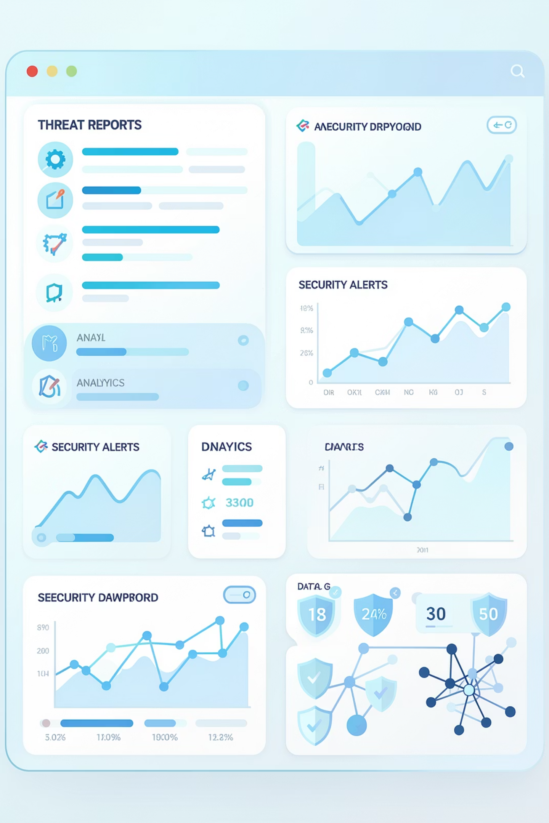
UI Design: Threat Intelligence Dashboard
Streamlit Interface Features
Key Functionalities
The dashboard enables analysts to query threat databases using plain English, compare multiple threats side-by-side, and generate comprehensive reports with risk scores, affected systems, and recommended mitigation strategies in seconds.
Natural language query input with autocomplete
Real-time report generation with streaming output
Interactive threat timeline visualization
Export options (PDF, JSON, Markdown)
Dark mode optimized for security operations

Slide 9



Sample Threat Report: CVE Analysis
Report: Remote Code Execution in Apache HTTP Server
CVE-2024-1234 | Critical Severity | CVSS Score: 9.8
Threat Summary
Apache HTTP Server versions 2.4.52 through 2.4.58 contain a critical vulnerability allowing remote attackers to execute arbitrary code via crafted HTTP requests. Exploitation requires only network access to vulnerable servers.
Affected Systems
Apache HTTP Server 2.4.52-2.4.58
Cloud infrastructure deployments
Enterprise web servers
Risk Assessment
95%
9.8
Exploit Likelihood
CVSS Score
Mitigation Steps
Upgrade to Apache 2.4.59 or later
Deploy WAF rules blocking malicious patterns
Implement network segmentation

Slide 10




Project Impact & Future Directions
Performance Advantage
Security First
Local RAG processing eliminates cloud latency, enabling real-time threat response without data privacy concerns
On-premise deployment ensures sensitive threat intelligence never leaves organizational networks
Future Roadmap
Integration with SIEM platforms, automated incident response, and predictive threat modeling using temporal analysis
This project demonstrates the feasibility of local AI-powered threat intelligence systems, providing organizations with enterprise-grade security analytics without cloud dependencies or data privacy risks.

